Slide 1


Traffic Management System: Phase IV
In this project, we aim to dynamically adjust the timing of traffic signals by analyzing the traffic using sensors such as HC-SR04, DHT-22, and ESP32. Building upon the previous phase, we have upgraded our model from ESP32 to Raspberry Pi for enhanced performance and capabilities.

Slide 2


The Previous Phase
1
Phase 1
Conducted extensive research on traffic patterns and designing a solution for the problem.
2
Phase 2
Research on how to implement our design and gain knowledge about sensors.
3
Phase 3
Implemented the design and constructed a prototype using the following sensors
(HC-SR04,DHT-22 & ESP-32)

Slide 3
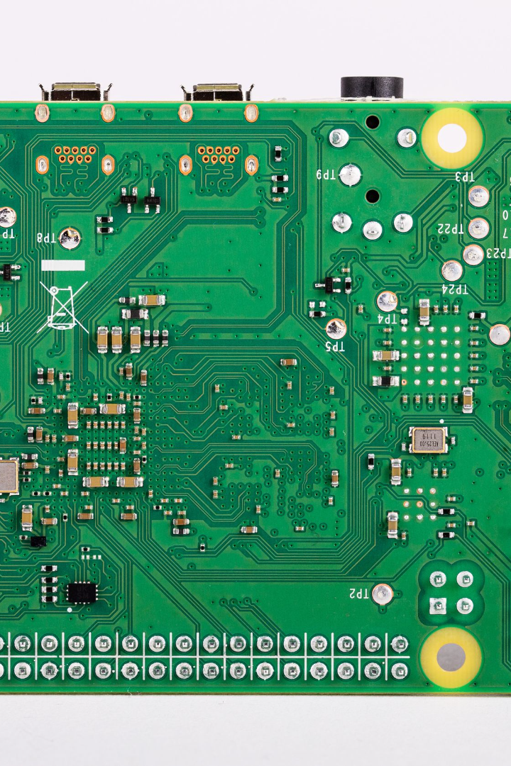
Introducing Raspberry Pi
Raspberry Pi is a powerful microcomputing device that has revolutionized the world of embedded systems. With its compact size and low cost, it provides the perfect platform for our traffic signal timing algorithm. The Raspberry Pi allows us to implement advanced data processing and analysis algorithms, improving the accuracy and efficiency of our system.

Slide 4

Key Features:
Affordability: Raspberry Pi boards are remarkably affordable, making them accessible to a wide range of users, from hobbyists to professionals.
Versatility: They can be used for a multitude of purposes, including desktop computing, robotics, home automation, gaming, and as a media center.
GPIO Pins: The Raspberry Pi includes GPIO (General Purpose Input/Output) pins, allowing it to interact with the physical world, making it ideal for projects involving sensors, motors, and other hardware components.
Community and Support: The Raspberry Pi community is vast and active. There's a wealth of online resources, forums, and tutorials available, making it easy to find help and inspiration for projects.
Operating Systems: Raspberry Pi supports various operating systems, including Raspbian (now called Raspberry Pi OS), Ubuntu, and even Windows IoT Core.

Slide 5
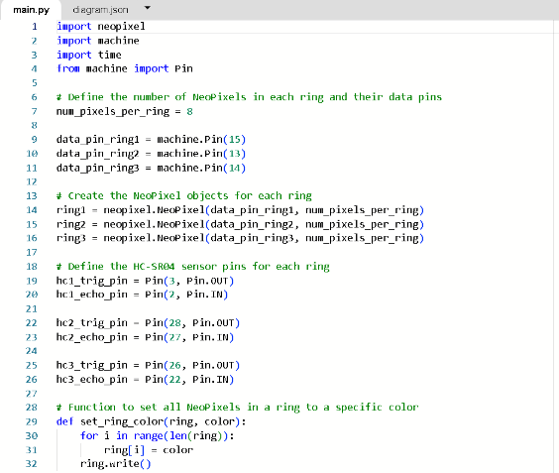
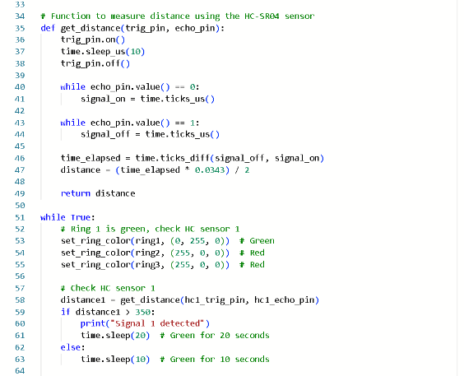
CODE & PROTOTYPE
In this section, we will present the code snippets and prototype of our traffic signal timing adjustment system.
CODE

Slide 6
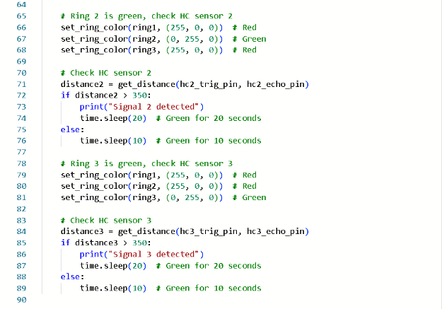

Slide 7
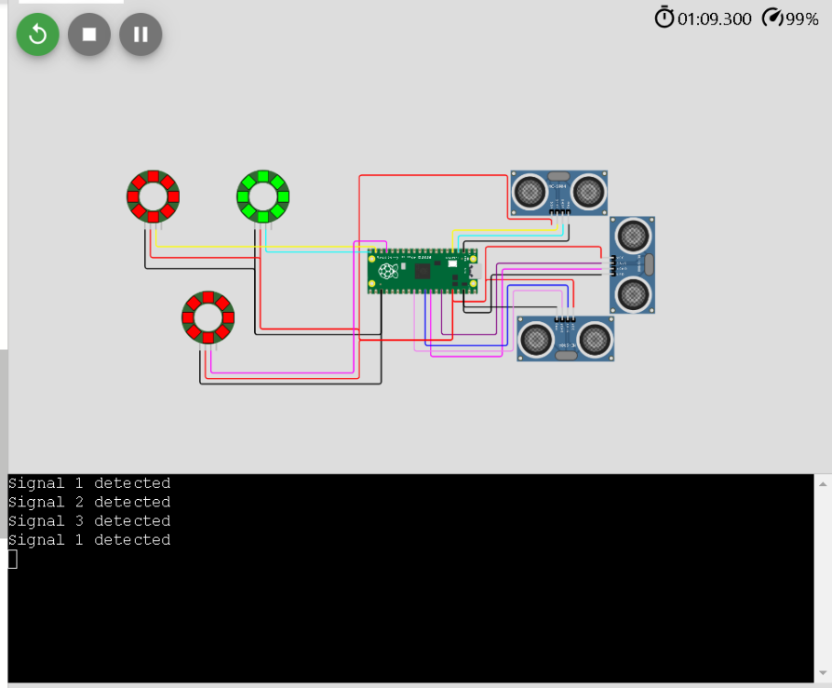
PROTOTYPE

Slide 8

Web- Interface
a dynamic platform that encapsulates the essence of our innovation. This interface serves as a comprehensive hub, featuring an in-depth description of our project alongside a direct link to explore the working prototype. Users can effortlessly delve into the project's details and experience its functionalities firsthand. This user-friendly interface embodies accessibility and convenience, ensuring a seamless interaction with our project.
The platform is in a beta version and yet to be developed

Slide 9
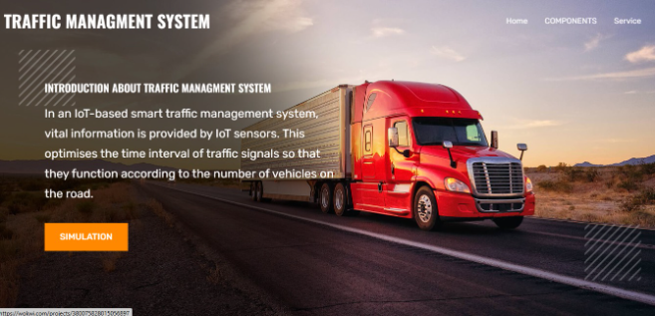
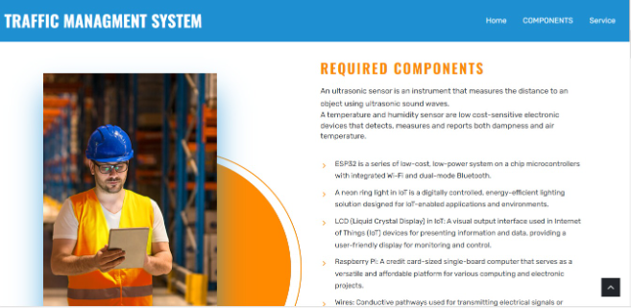

Slide 10
Benefits of Dynamic Signal Timing
Reduced Congestion
Improved Safety
Energy Efficiency
By responding to real-time traffic conditions, our system minimizes congestion and improves travel time.
Optimized traffic flow reduces the risk of accidents and enhances overall road safety.
By reducing idling time and unnecessary stops, we contribute to a more environmentally friendly transportation system.

Slide 11

Cloud Connection for Data Transfer
As we strive to make our system even more robust and efficient, we are trying to implementation of cloud connectivity. By establishing a connection to the cloud, we will be able to seamlessly transfer data from our traffic signal analysis to a centralized server, enabling real-time monitoring and optimization of traffic flow.

Slide 12
Conclusion
As we move forward, the addition of cloud connectivity will enable us to take our traffic signal timing system to new heights. By transferring data to the cloud, we create opportunities for advanced analysis and real-time optimization. Together, we can revolutionize the way traffic is managed, creating safer, more efficient road networks for all.

